Slide 1
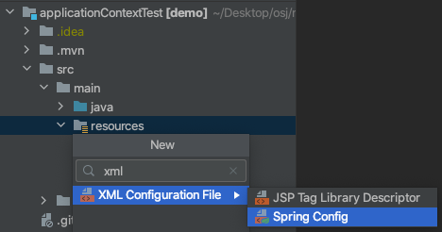

Slide 2
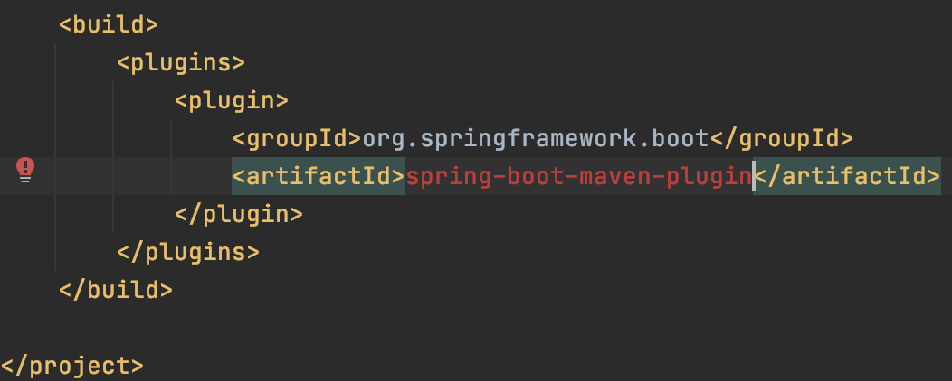
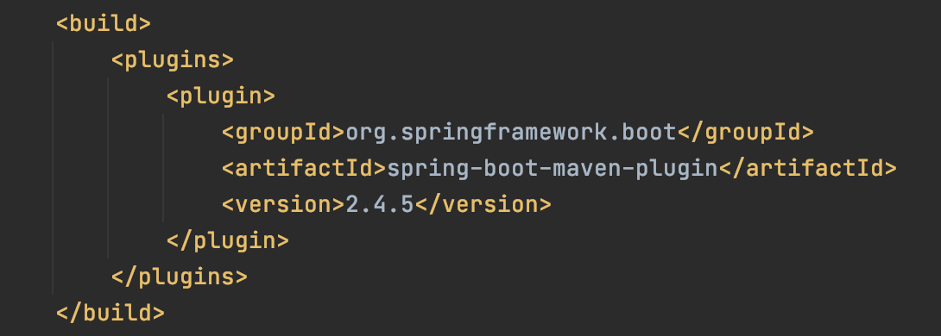
The packaging for this project did not assign a file to the build artifact
버전 추가하면 됨.

Slide 3
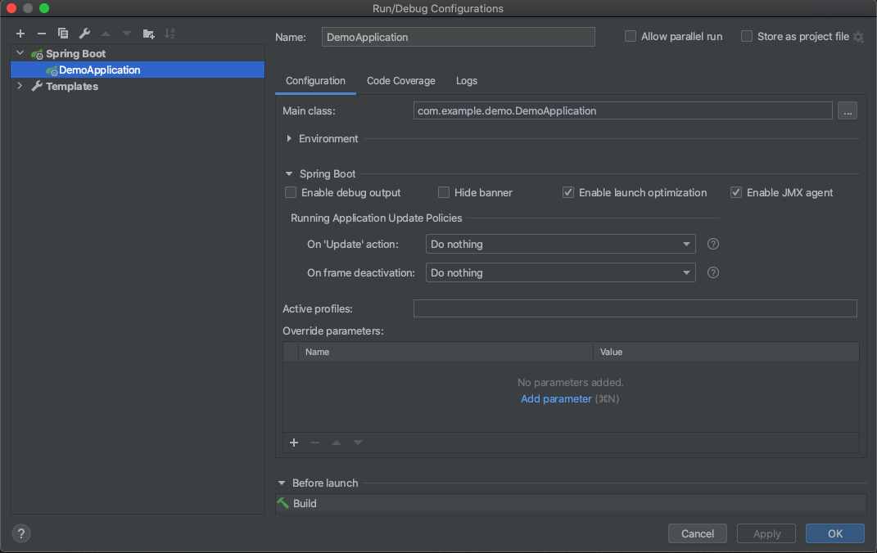


“test”

Slide 4
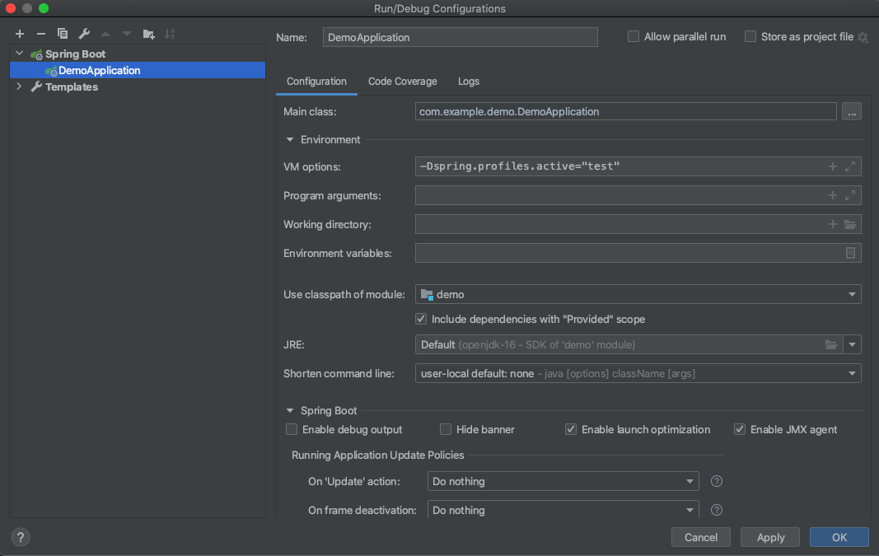

Slide 5
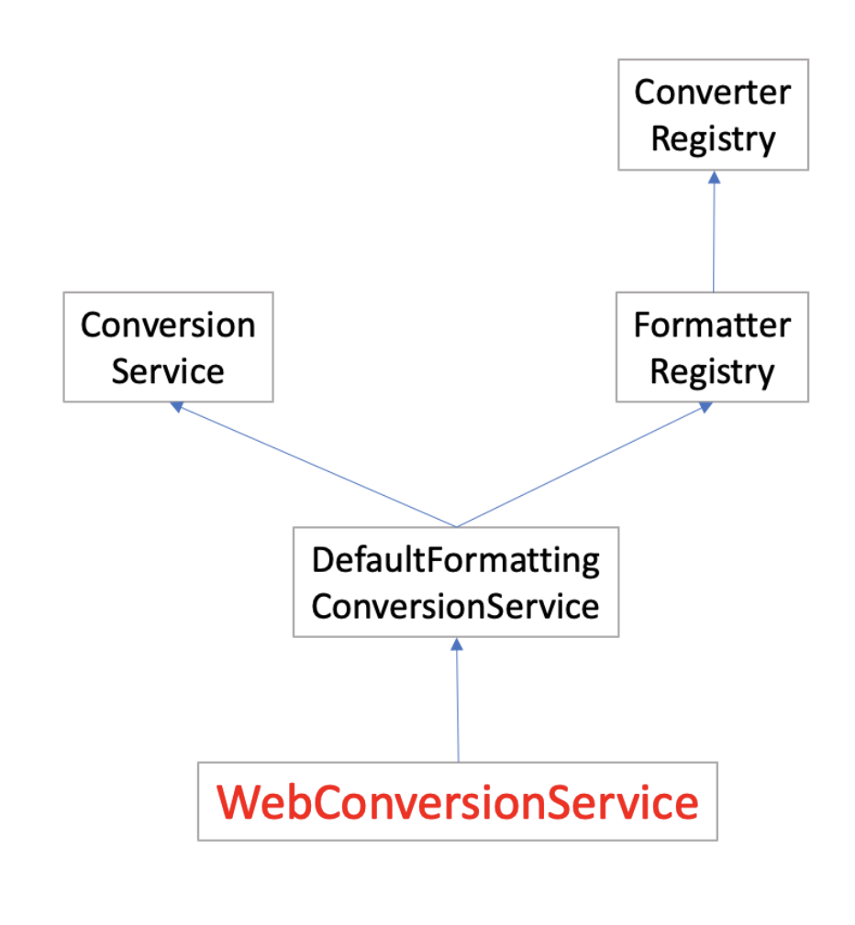

Slide 7
Converter
Registry
Conversion
Service
Formatter
Registry
DefaultFormatting
ConversionService
WebConversionService

